Slide 1
Letting Users Create, Read, Update, and Delete Movie Reviews
AMI PAtel

Slide 2
contents
Letting users post movie reviews
Creating a review
Listing reviews
Updating a review
Deleting a review
Implementing authorization

Slide 3
In movie/models.py, add the following to define a Review model:
from django.contrib.auth.models import User
class Review(models.Model):
text=models.CharField(max_length=100)
date=models.DateTimeField(auto_now_add=True)
user=models.ForeignKey(User,on_delete=models.CASCADE)
movie=models.ForeignKey(Movie,on_delete=models.CASCADE)
watchAgain=models.BooleanField()
def __str__(self):
return self.text

Slide 4
Register Review model to admin
from .models import Movie,Review
admin.site.register(Movie)
admin.site.register(Review)
In the terminal, make the migration for the new model and apply the changes to the sqlite3 database:
python manage.py makemigrations
python manage.py migrate

Slide 5
Creating a review
We first create a path in /movie/urls.py:
urlpatterns = [
path("",views.home, name='home'),
path("about/",views.about),
path("signup/",views.signup,name='signup'),
path('<int:movie_id>/', views.detail, name='detail'),
path('<int:movie_id>/create', views.createreview,name='createreview'),
]
urlpatterns+=static(settings.MEDIA_URL,document_root=settings.MEDIA_ROOT)

Slide 6
/movie/views.py
from django.shortcuts import get_object_or_404, redirect
from .models import Movie, Review
from .forms import ReviewForm
def createreview(request, movie_id):
movie = get_object_or_404(Movie,pk=movie_id)
if request.method == 'GET':
return render(request, ' movie/createreview.html',{'form':ReviewForm(), 'movie':movie})
else:
try:
form = ReviewForm(request.POST)
newReview = form.save(commit=False)
newReview.user = request.user
newReview.movie = movie
newReview.save()
return redirect(' detail',newReview.movie.id)
except ValueError:
return render(request,' movie/createreview.html',{'form':ReviewForm(),'error':'bad datapassed in'})

Slide 7
/movie/templates/ movie/ createreview.html
<p class="card-text">
<form method="POST">
{% csrf_token %}
{{ form.as_p }}
<button type="submit"
class="btn btn-primary">
Add Review
</button></form></p></div></div></div></div>
{% endblock content %}
{% extends 'base.html' %}
{% block content %}
<div class="card mb-3">
<div class="row g-0">
<div><div class="card-body">
<h5 class="card-title">Add Review for {{movie.title }}</h5>
{% if error %}
<div class="alert alert-danger mt-3"role="alert">
{{ error }}
</div>
{% endif %}

Slide 8
In /movie, create the forms.py file
from django.forms import ModelForm, Textarea
from .models import Review
class ReviewForm(ModelForm):
def __init__(self, *args, **kwargs):
super(ModelForm, self).__init__(*args,**kwargs)
self.fields['text'].widget.attrs.update({'class': 'form-control'})
self.fields['watchAgain'].widget.attrs.update({'class': 'form-check-input'})
class Meta:
model = Review
fields = ['text','watchAgain']
labels = {'watchAgain': ('Watch Again')}
widgets = {'text': Textarea(attrs={'rows': 4}),}

Slide 9
Update /movie/templates/ movie/ detail.html
{% if movie.url %}
<a href="{{ movie.url }}"
class="btn btn-primary">
Movie Link
</a>
{% endif %}
{% if user.is_authenticated %}
<a href="{% url 'createreview' movie.id %}"
class="btn btn-primary">
Add Review
</a>
{% endif %}

Slide 10
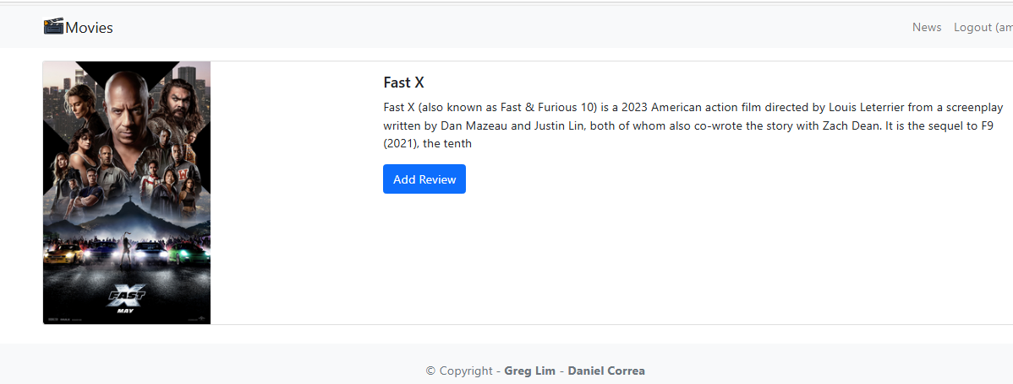
Movie detail page

Slide 11
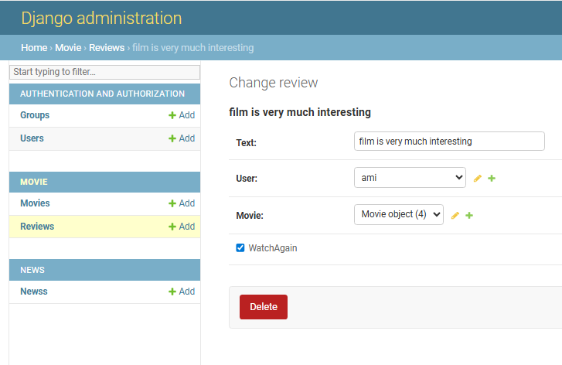
After adding review check the admin panel

Slide 12
Listing reviews Now, we want to list a movie's reviews on the movie details page
In /movie/views.py
def detail(request, movie_id):
movie = get_object_or_404(Movie,pk=movie_id)
reviews = Review.objects.filter(movie = movie)
return render(request, 'movie/detail.html',{'movie':movie,'reviews': reviews})

Slide 13
in /movie/templates/movie/ detail.html
Movie Link
</a>
{% endif %}
{% if user.is_authenticated %}
<a href="{% url 'createreview' movie.id %}"class="btn btn-primary">Add Review</a>
{% endif %}
</p>
<hr />
<h3>Reviews</h3>
<ul class="list-group">
{% for review in reviews %}
<li class="list-group-item pb-3 pt-3">
<h5 class="card-title">
Review by {{ review.user.username }}
</h5>
<h6 class="card-subtitle mb-2 text-muted">
{{ review.date }}
</h6>
<p class="card-text">{{ review.text }}</p>
{% if user.is_authenticated and user == review.user %}
<a class="btn btn-primary me-2"href="#">Update</a>
<a class="btn btn-danger"href="#">Delete</a>
{% endif %}
</li>
{% endfor %}
</ul>
</div></div></div></div></div>
{% endblock content %}

Slide 14
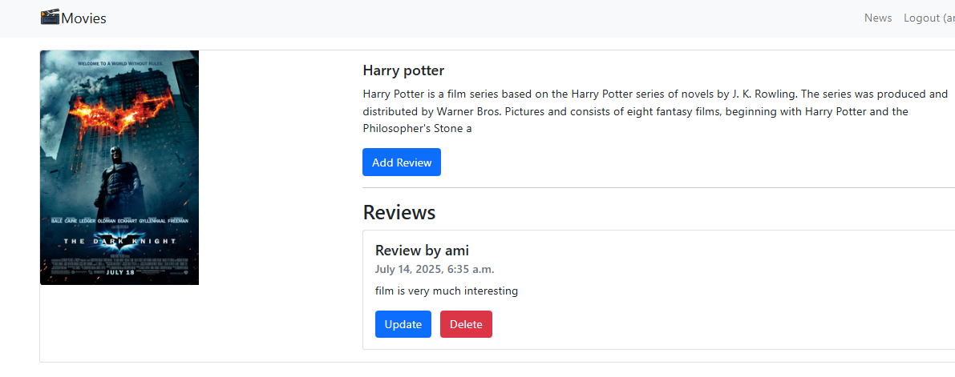

Slide 15
Updating a review in /movie/urls.py:
path('review/<int:review_id>', views.updatereview, name='updatereview'),

Slide 16
In /movie/views.py
def updatereview(request, review_id):
review = get_object_or_404(Review,pk=review_id,user=request.user)
if request.method == 'GET':
form = ReviewForm(instance=review)
return render(request, 'movie/updatereview.html',{'review': review,'form':form})
else:
try:
form = ReviewForm(request.POST,instance=review)
form.save()
return redirect(‘detail', review.movie.id)
except ValueError:
return render(request,'movie/updatereview.html',{'review': review,'form':form,'error':'Bad data in form'})

Slide 17
/movie/templates/ movie/ updatereview.html
{% extends 'base.html' %}
{% block content %}
<div class="card mb-3">
<div class="row g-0">
<div>
<div class="card-body"> <h5 class="card-title">
Update Review for {{ review.movie.title }}
</h5>
{% if error %}
<div class="alert alert-danger mt-3"
role="alert">
{{ error }}
</div>
{% endif %}
<p class="card-text">
<form method="POST">
{% csrf_token %}
{{ form.as_p }}
<button type="submit"
class="btn btn-primary">
Update Review
</button>
</form>
</p>
</div>
</div>
</div> </div>
{% endblock content %}

Slide 18
/movie/templates/ movie/ detail.html
{% if user.is_authenticated and user ==
review.user %}
<a class="btn btn-primary me-2"
href="{% url 'updatereview' review.id %}">
Update
</a>
<a class="btn btn-danger"
href="#">Delete</a>
{% endif %}

Slide 19
Deleting a review
Create a new path to delete a review in /movie/urls.py
path('review/<int:review_id>/delete', views.deletereview, name='deletereview’),
In /movie/views.py
def deletereview(request, review_id):
review = get_object_or_404(Review, pk=review_id,
user=request.user)
review.delete()
return redirect('detail', review.movie.id)

Slide 20
/movie/templates/ movie/detail.html
{% if user.is_authenticated and user ==
review.user %}
<a class="btn btn-primary me-2"
href="{% url 'updatereview' review.id
%}">
Update
</a>
<a class="btn btn-danger"
href="{% url 'deletereview' review.id %}">
Delete
</a>
{% endif %}

Slide 21
Implementing authorization
/movie/views.py
from django.contrib.auth.decorators import login_required
@login_required
def createreview(request, movie_id):
…
@login_required
def updatereview(request, review_id):
…
@login_required
def deletereview(request, review_id):

Slide 22
/accounts/views.py
from django.contrib.auth.decorators import login_required
…
@login_required
def createreview(request, movie_id):
…
@login_required
def updatereview(request, review_id):
…
@login_required
def deletereview(request, review_id):

Slide 23
/accounts/views.py
from django.contrib.auth.decorators import
login_required
…
@login_required
def logoutaccount(request):
…
/settings.py
LOGIN_URL = 'loginaccount'

